Slide 1
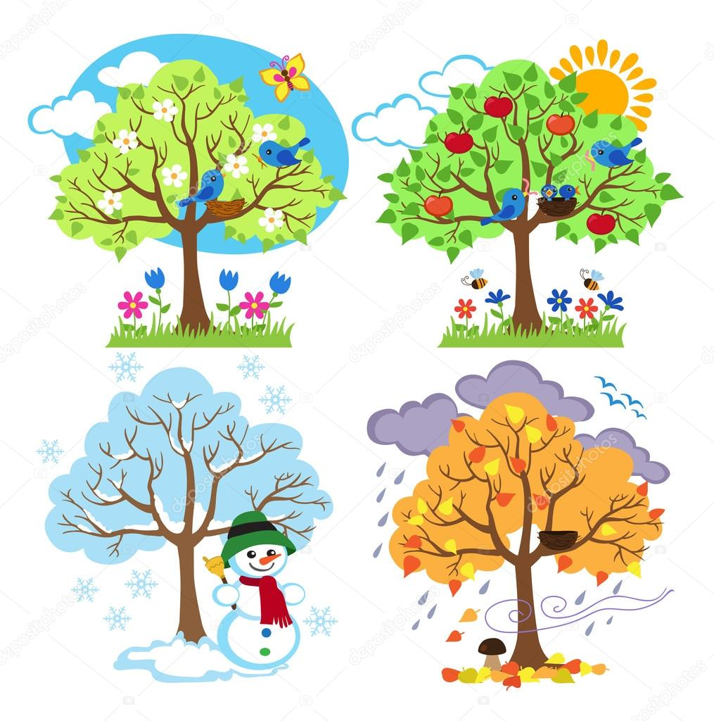
A song of seasons
Unit 1 Lesson
6th form
Spînu Rodica,
Onisifor Ghibu School

Slide 2
Objectives of the lesson
-will talk about the importance of season
-will describe the season;
-Will practise Present Simple
-will express own opinion about season
-will learn new words related to the topic;
-read a text and answer the questions

Slide 3
Discussion questions
1.When you see this picture , what comes to your mind? What are we going to speak about today?
2. What is the season you like best? Why? 3 reasons
I like ……. because …..
We can …..
3. What makes you happy /sad about winter/spring /summer/ autumn?
The thing that/which makes me happy is the fact that we can/can’t…..

Slide 4
Discussion questions
4.What is the best season to visit our country? why?
In my opinion the best season is … as one has the possibility to ….
5.What colour do you associate each season with?
For me spring/winter/ is associated with … because….
6. If you had the chance to eliminate a season , which one would it be?
I would eliminate ….. because …

Slide 5
Discussion questions
7.Which season you can’t imagine
living without?
Personally I think I can’t live ……
8.What activities do we do in each
month ,?
There are many activities but some of them might be …….

Slide 6

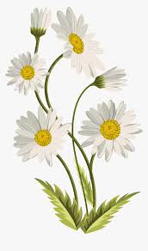

New words
daffodil
daisy
wheat

Slide 7


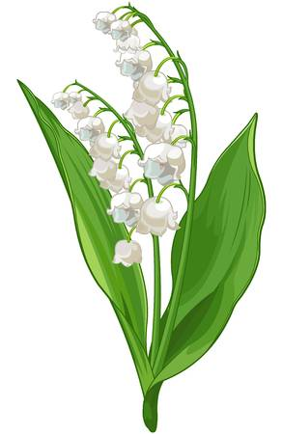
New words
Sun-flower
poppy
Lily of the valley

Slide 8
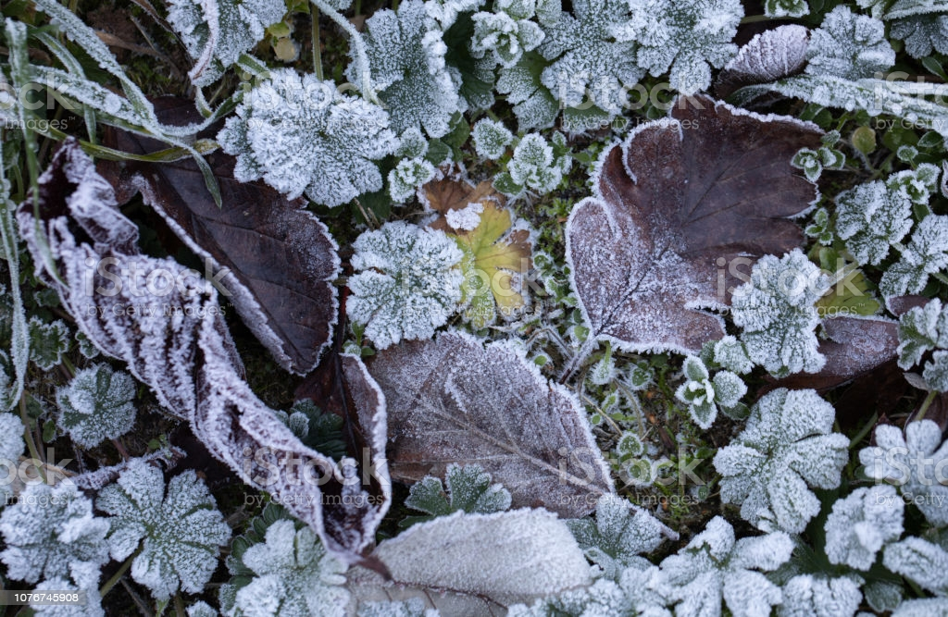
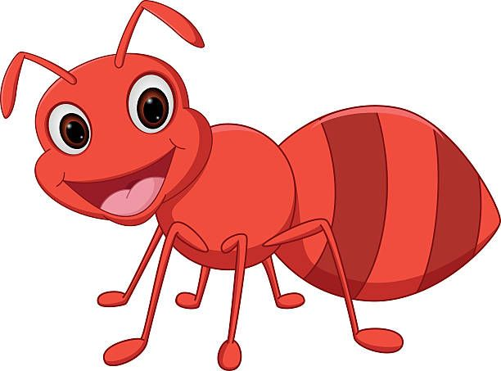
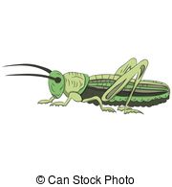
New words
ant
hoar frost
grasshopper

Slide 9
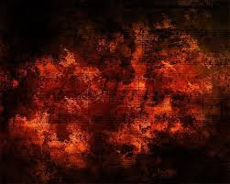
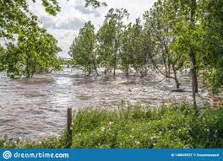
New words
rust-coloured
swelling river

Slide 10

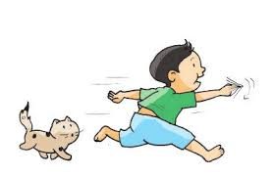
New words
Misty=foggy
frolic

Slide 11
Reading comprehension
1.What kind of text is this?
2.What is the purpose of fables?
-It has animals and things as characters that/which teach us life lessons.
3.Who are the characters of the fable?
4. What did he do one day?
5. What did the ant do that day?
6.Why did she work?

Slide 12
Reading comprehension
6.What happened when winter came?
7.How did she feel in winter? What about him?
8.How can you describe the ant?
WHO CAN YOU ASSOCIATE THE ANT WITH AT SCHOOL?
9.Describe the grasshopper
WHO CAN YOU ASSOCIATE THE GRAHOPPER WITH AT SCHOOL?

Slide 13
DESCRIBE THE ANT
PUNCTUAL
HARD-WORKING
INDUSTRIOUS
RESPONSIBLE
GOOD
PUPIL
DILIGENT
SENSIBLE
WELL-ORGANIZED
RATIONAL
CAREFUL
INDEPENDENT

Slide 14
DESCRIBE THE GRASSHOPPER
IRRESPONSIBLE
LAZY
ABSENT-MINDED
INDIFFERENT
bad
PUPIL
SILLY
INSENSIBLE
BADLY-ORGANIZED
IRRATIONAL
CARELESS
INDIFFERENT

Slide 15
1.DO THINGS ON TIME
2.BE ATTENTIVE
3.BE RESPONSIBLE AND INDEPENDENT
4.BE PUNCTUAL
5.DO YOUR BEST
6.DON’T NEGECT HOMEWORK
7.DON’T CUT LESSONS
What should you do to be
like the Ant?

